Slide 1
PORTS

Slide 2
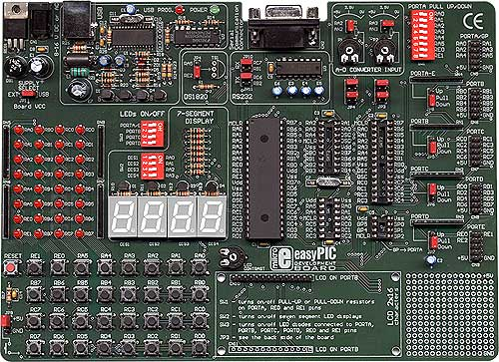
PIC PERIPHERALS

Slide 3
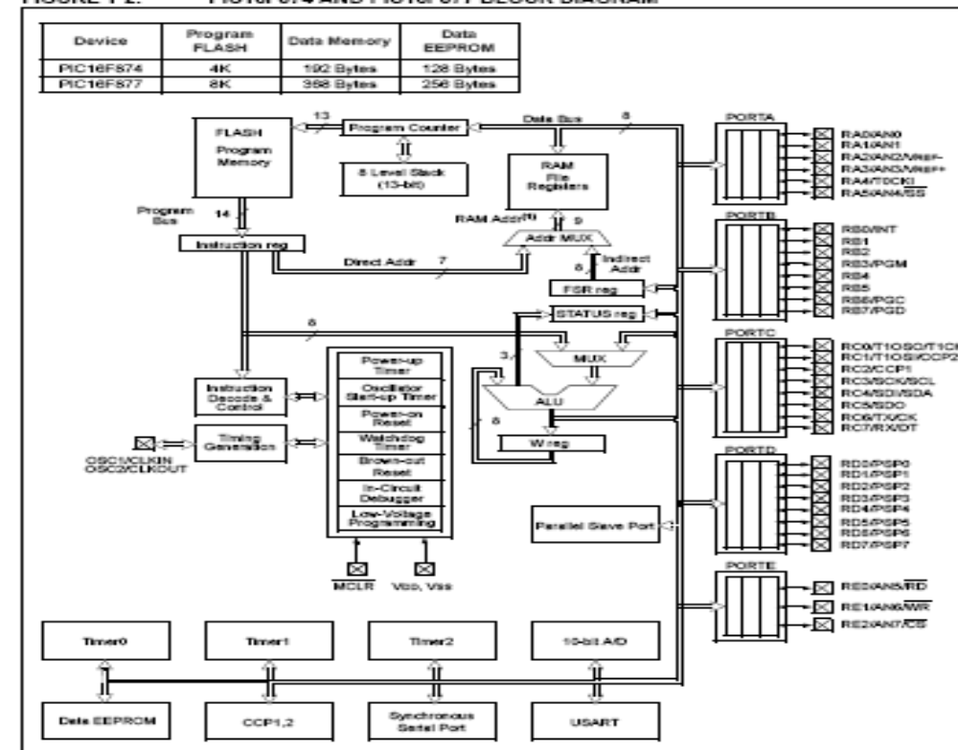

Slide 4
Peripherals
uC has a set of peripherals
One of the distinct feature→ Presence of such frequently used peripherals
They are offered with enough flexibility
Commonly used peripherals are IO ports

Slide 5
I/O PORTS
(Simplest Peripherals)
PORT A : 6 bits wide (7th and 8th bit always read as 0)
PORT B : 8 bits wide
PORT C : 8 bits wide
PORT D : 8 bits wide
PORT E : 3 bits wide
Each port transfers data to/from the CPU (standard I/O function)
Additionally, each one can also transfer data to/from one or more of the other peripheral devices (Peripheral I/O function)
Need to use various registers to specify which function (standard I/O or peripheral I/O) each port bit is going to do.

Slide 6
I/O PORTS
Simplest of the peripherals
Pins are multiplexed with alternate functions
TRIS Register
  Data direction register TRIS<x> controls the direction of port<x>
  1 configures as input and 0 as output

Slide 7
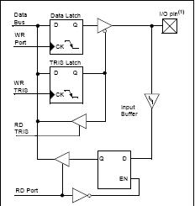
GENERAL STRUCTURE OF AN I/O PORT TO PERFORM STANDARD I/O FUNCTION

Slide 8
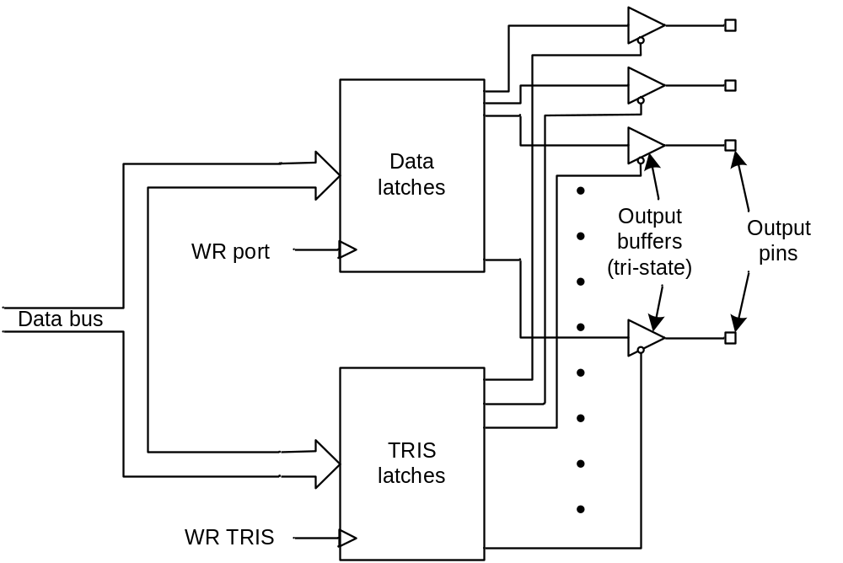
SET OF DATA AND TRIS LATCHES AT EACH PORT

Slide 9
org 0x00
Main:
bsf STATUS, RP0 ; Select bank 1
movlw 0x00 ; WREG = 0x00
movwf TRISB ; TRISA = WREG, Port A is output
movlw 0xFF ; WREG = 0xFF
movwf TRISD ; TRISA = WREG, Port D is input
bcf STATUS, RP0 ; Select bank 0
main_loop:
movf PORTD, W ; WREG = PORTD, read Port D to WREG
movwf PORTB ; PORTA = WREG, Output WREG to Port A
goto main_loop ; Goto main_loop
end ; Physical end of program
I/O Ports initialization

Slide 10
QUICK REVIEW...!

Slide 11
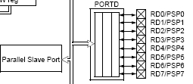
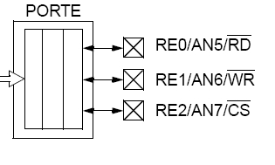
PORTS D and E

Slide 12
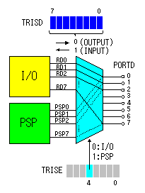
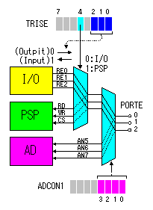
PORT D
8 bits wide
I/O directions set by TRISD <0:7>
PORT E
ADCON1
To use as I/O or PSP, set pins as digital inputs.
To use as analog inputs, set pins as analog inputs
3 bits wide
I/O directions set by TRISE <0:2>
In PSP and Analog mode, direction should always be input.

Slide 13
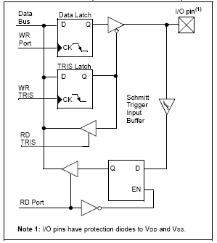
PORTS D,E in I/O mode

Slide 14
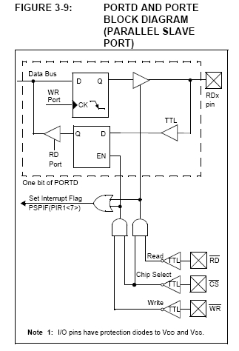
PORTS D,E in PSP MODE

Slide 15
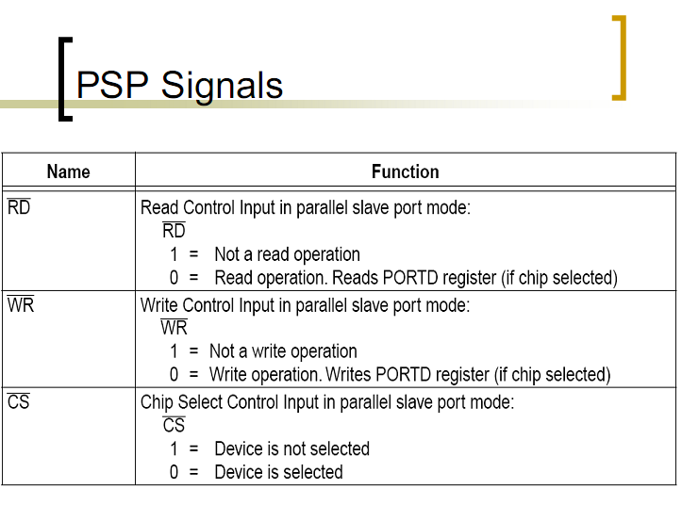

Slide 16
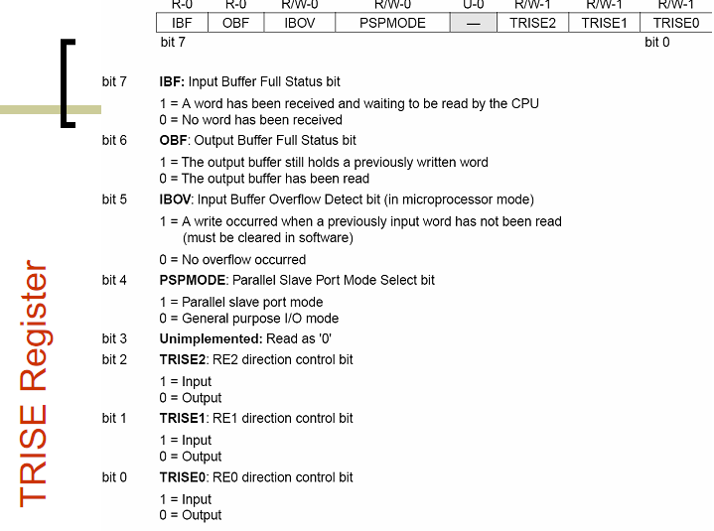

Slide 17

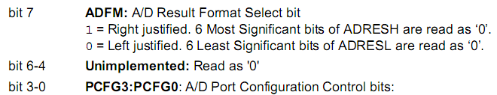
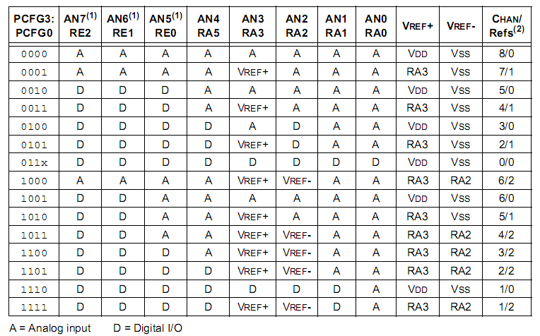

Slide 18
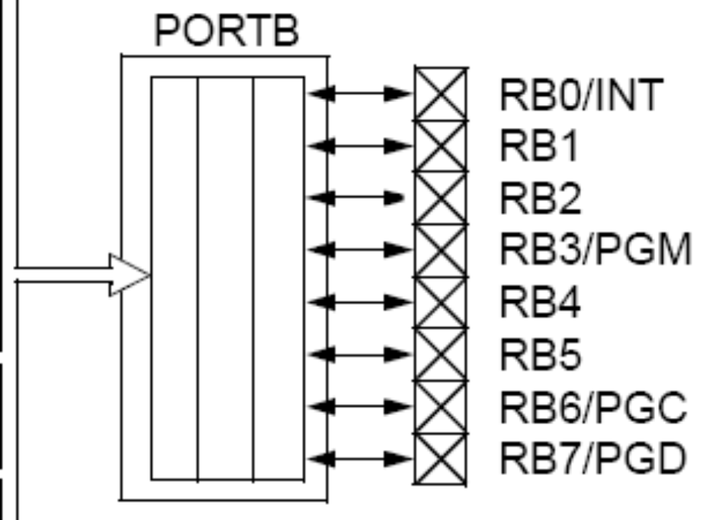
PORT B
1) 8 bit port.
2) PIN 0 is multiplexed with external interrupt pin (if GIE is enabled, then external interrupt will be accepted).
3) Pins 3,6,7 are multiplexed with pins needed for LOW voltage programming of the in-circuit debugger.
  By default, Low Voltage Mode is enabled.
  Need to disable it to be able to use RB3,6,7 as I/O pins

Slide 19
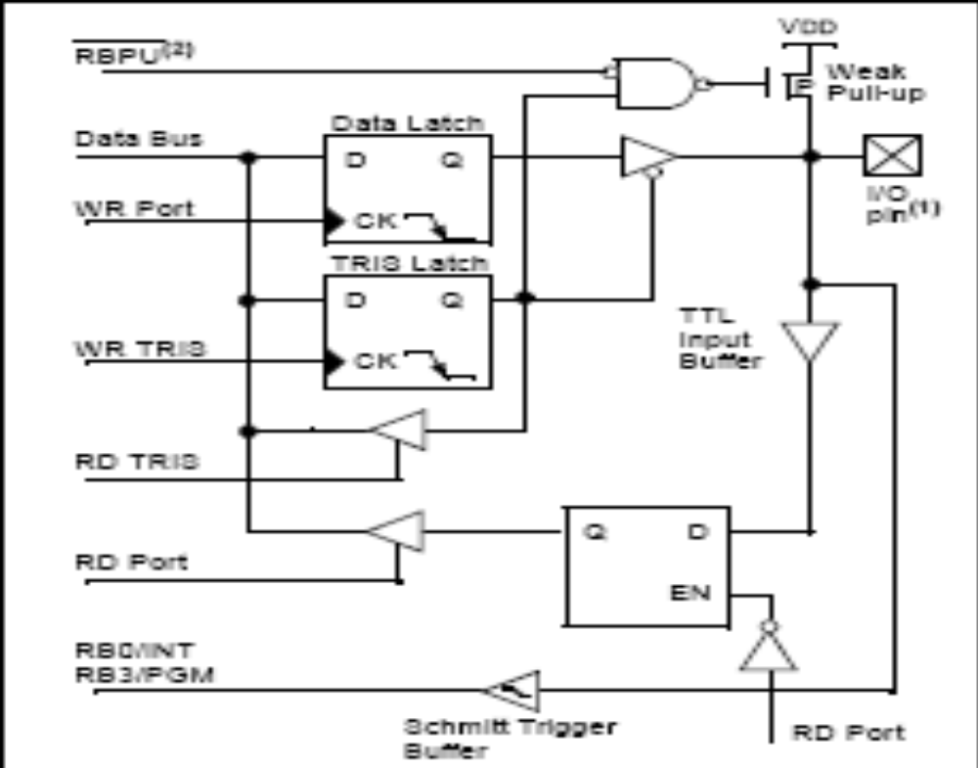
PORT B
STRUCTURE
To peripheral module
In Low Voltage Programming mode (LVP) mode, pins 3,6,7 are not regular I/Os but goes as inputs to in circuit debugger

Slide 20

WEAK PULLUP
  All pins of port B have a weak Pull up.
  If pin is in input mode and is floating, it can pick up stray signals and damage ICs. Hence drive it to a weak high value by connecting it through a weak pullup transistor. This weak value can be overwritten by external input when data arrives.
  Pull up Enabled by bit 1 (RBPU) of OPTION_REG.
  Automatically disabled if TRISB = 0 (output mode).

Slide 21
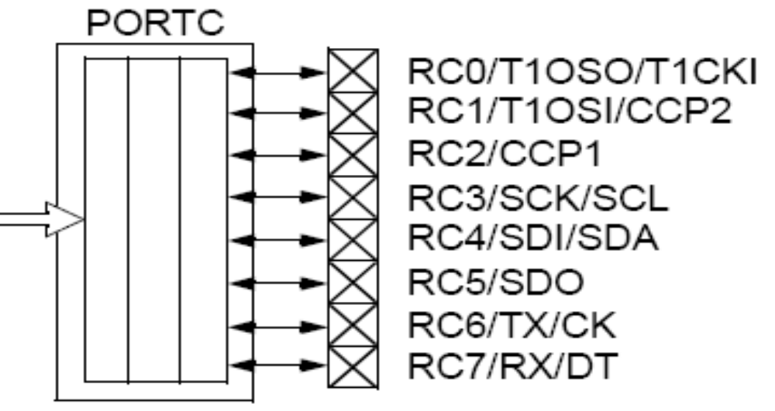
PORT C

Slide 22
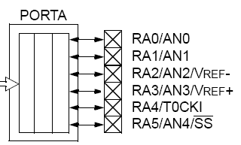
PORT A
6 bit port (A0 – A5) ;
Multiplexed with A/D converter , Timer 0 and SSP (synchronous slave port) modules
If want to use digital I/O, we need to set the pins as digital by modifying the value of ADCON1 (one of the values : ADCON1 = 0x06 will make all pins digital.

Slide 23
PORT A INITIALIZATION
;; select BANK 0
BCF STATUS, RP0
BCF STATUS, RP1
CLRF PORTA ;
;; Select bank 1
BSF STATUS, RP0
MOVLW 0x06
MOVWF ADCON1 ; configure all pins as digital I/O
MAKE AS input/output BY MOVING TO TRIS B.

Slide 24
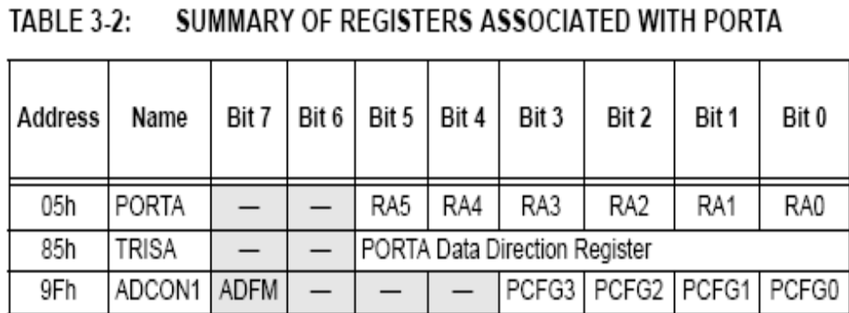
just go through the datasheets for more details

